Slide 1
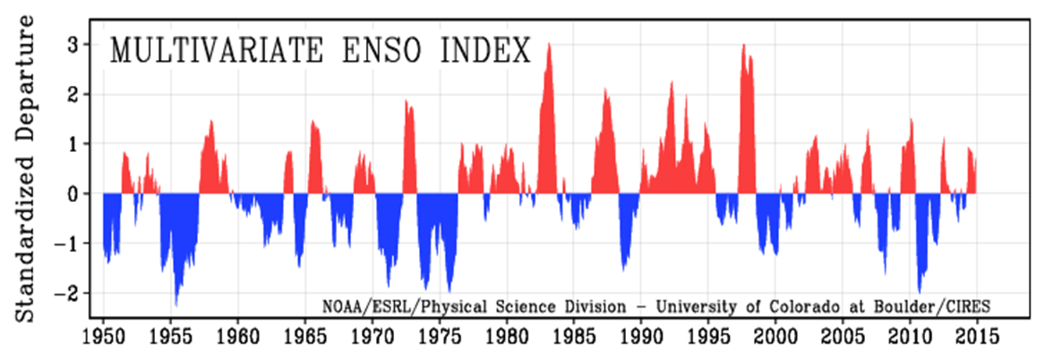
ENSO
Minnesota Declaration Frequency
Notes:
1333-Granite Falls Tornado
1370-Statewide Flooding (62 Counties/Tribes)
1419-Severe Flooding (19)

